Slide 1
Modular Arithmetic Essentials
John York
Shenandoah Valley Governor’s School
Spring 2023

Slide 2
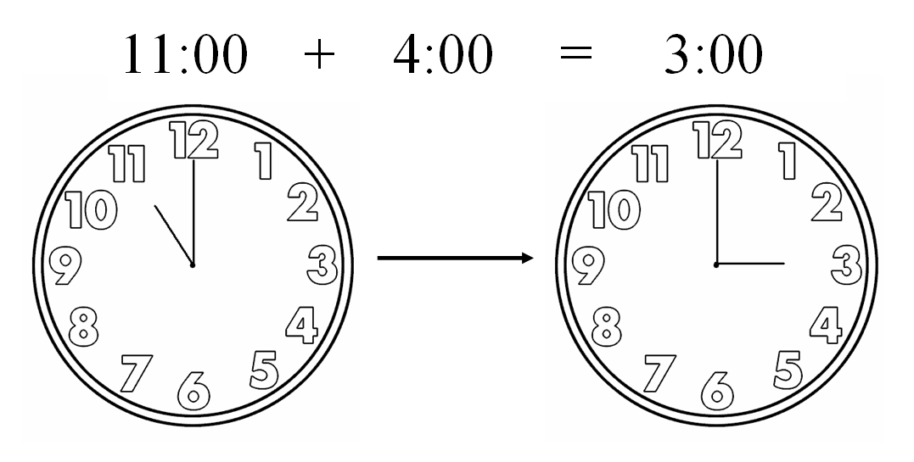
Modular arithmetic “wraps”
Easy enough for simple problems, but complex problems with gigantic numbers become hard to solve

Slide 3
Modular addition “wraps”
In a 12-hour clock, what is 6 hours after 10 o’clock?
10 + 6 = 16, but that doesn’t fit inside the 0 - 11 hours on the clock
16 - 12 = 4, so the answer is 4 o’clock -- “wraps”
16 / 12 = 1 remainder 4 (division returns number of wraps; 1 this time)
16 mod 12 = 4 -- the remainder (how far you go after wraps are done)
With 26 letters, indexed 0 – 25 (starts at 0, not 1)
15 + 20 = 35, but that isn’t in 0 - 25
35 - 26 = 9, so 15 + 20 “wraps” to 9
35/26 = 1 remainder 9
35 mod 26 = 9 -- the remainder

Slide 4
Modular subtraction also “wraps”
12-hour clock, what is 10 hours before 2?
2 - 10 = -8 -- that’s not between 0 and 11
-8 + 12 = 4 -- 4 o’clock is 10 hours before 2
-8 mod 12 = 4
26 letters, indexed 0 - 25
2 - 10 = -8
-8 + 26 = 18
-8 mod 26 = 18

Slide 5
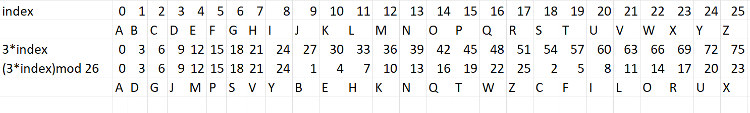
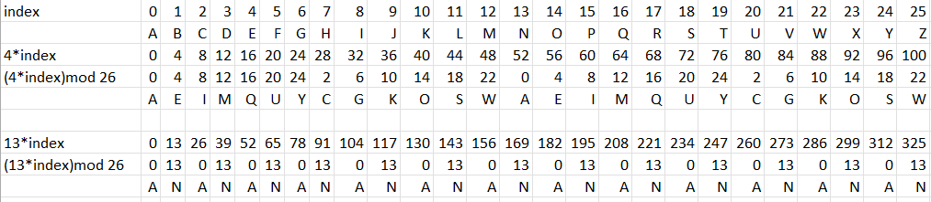
Modular multiplication (1)
Multiplication jumbles things a little--handy for encryption
But what happened here?

Slide 6
3*index—1 to 1 map 13*index—OOPS!
A O
B P
C Q
D R
E S
F T
G U
H V
I W
J X
K Y
L Z
M
N
A O
B P
C Q
D R
E S
F T
G U
H V
I W
J X
K Y
L Z
M
N
A O
B P
C Q
D R
E S
F T
G U
H V
I W
J X
K Y
L Z
M
N
A O
B P
C Q
D R
E S
F T
G U
H V
I W
J X
K Y
L Z
M
N

Slide 7
Modular Multiplication (2)
If multiplier and the modulus share a common divisor,
Multiplication “wraps” onto same space, over and over
Example: (13 * index) mod 26
13 and 26 are both divisible by 2, so 2 is common divisor
0 and 13 are the only answers we get
Not good for encryption
But if the modulus were 29 instead of 26…
29 is a prime number, it is only divisible by 1
We could multiply by any number 0 - 28 without problems

Slide 8
Greatest Common Divisor (GCD)
Take two numbers
GCD is the largest number that can divide both
GCD(2, 26) = 2
GCD(18, 26) = 2
GCD(13, 26) = 13
GCD(3, 26) = 1 -- no common divisor, relatively prime
GCD = 1 means the two numbers
have no common divisor
are relatively prime
Euclid developed a method for finding GCD over 2,000 years ago

Slide 9
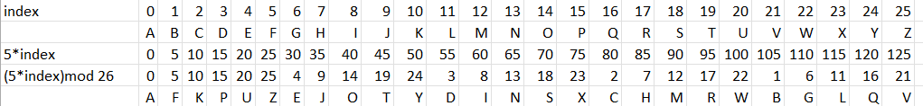
Modular Inverse (1)
Division doesn’t work in modular arithmetic
3 / 5 is a fraction, modular arithmetic only has integers
Instead use modular inverse
In real numbers 5 * 1 / 5 = 1 so 1 / 5 is the inverse of 5
5 * (mod inverse of 5 ) = 1
use wrapping--there must be some number that wraps to 1
5 * 21 = 105, 105 mod 26 = 1
So, 21 is the mod inverse of 5 when you are using mod 26

Slide 10
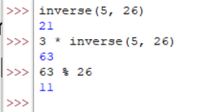
Modular Inverse (2)
The equivalent to division in modular arithmetic (sort of) is multiplication by the modular inverse.
3 / 5 from real number arithmetic in modulus 26 converts to
3 * inverse (5 in modulus 26)
= 3 * 21 = 63
= 63 mod 26
= 11
Check 5 * 11 mod 26 = 3

Slide 11
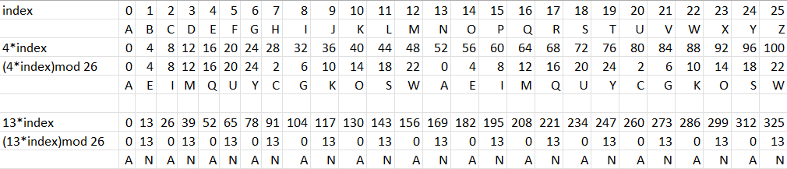
Mod Inverse requires GCD(number, mod) = 1
If the number and the modulus have common factors, no inverse exists.
GCD(4, 26) = 2
There is no “1” in the (4*index)mod26 line
GCD(13, 26) = 13 No “1” in that line either

Slide 12


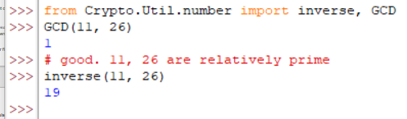
Computing Modular Multiplicative Inverses
Brute force
Try every number until a*i mod(n) = 1
(Should also check GCD(a, n) == 1 before start to ensure inverse exists)
Extended Euclidean Algorithm
Efficient algorithm
Available in the Util.number module of PyCryptodome
Notes:
The code in the top right is simple Python that incrementally tests numbers to see if they are multiplicative inverses. The Python range(n) function returns a list of integers between 0 and n-1. In our case n = 26, so it gives a list 0, 1, 2, …, 25. The break statement causes the for loop to quit when it finds the inverse we seek, where a * i % n = 1
Wikipedia has a nice explanation and a table showing several steps in the algorithm, as well as a mathematical proof. https://en.wikipedia.org/wiki/Extended_Euclidean_algorithm.
However, they didn’t give me any better feel for how the process works. Instead, this lecture by Christoff Paar was great! https://www.youtube.com/watch?v=fq6SXByItUI

Slide 13

Python
Python operators
% is the modulo (mod) operator, 97 % 6 will return 1
1 is the remainder when 97 is divided by 6
// is the integer division operator, 97 // 6 will return 16
16 * 6 + 1 = 97 (quotient * modulus + remainder gives us the initial number)
pow(number, power, modulus)
pow(3, 15, 26) computes 3¹⁵ mod 26
PyCryptodome functions in Util.number
GCD(96, 6) = 6
97 and 6 have common divisors, inverse should not work
inverse(96, 6) = 0
BIG OOPS! Always check GCD when using PyCryptodome inverse function!!!

Slide 14
Why this is important
Most encryption uses modular arithmetic
Multiplication happens *a lot* in encryption
Note: taking a number to a power is just repeated multiplication
Modular Inverse happens *a lot* in encryption
Modular Inverse does not exist unless GCD = 1
-> no common divisors, or relatively prime
Therefore, prime numbers are important in encryption
Whether or not the inverse exists is important in encryption

Slide 15
Mathematical Language—Integer Ring ℤ_{n}
Integer symbol is ℤ
The subset {0, 1, …, n} is the integer Ring ℤ_{n} (sometimes ℤ/nℤ )
The normal laws, Identity, Associative, Commutative, and Distributive work for modular arithmetic with addition and multiplication
ℤ_{n} is Closed under addition and multiplication
The inverse law works for addition, but may or may not work for multiplication
Remember ℤ₂₆ , where 2 does not have an inverse GCD(2, 26) = 2 ≠ 1

Slide 16
Prime Fields 𝔽
An integer ring ℤ_{n} , where n is a prime number, is a prime Field
ℤ_{p} , also written as 𝔽_{p}
In addition to the laws that work for rings, all members have a multiplicative inverse
GCD(i, p) = 1, for any i, because p is prime
ℤ₂₆ is just a ring, 26 is not prime (or is composite)
ℤ₂₉ is a ring, but also a field 𝔽₂₉ , 29 is prime

Slide 17
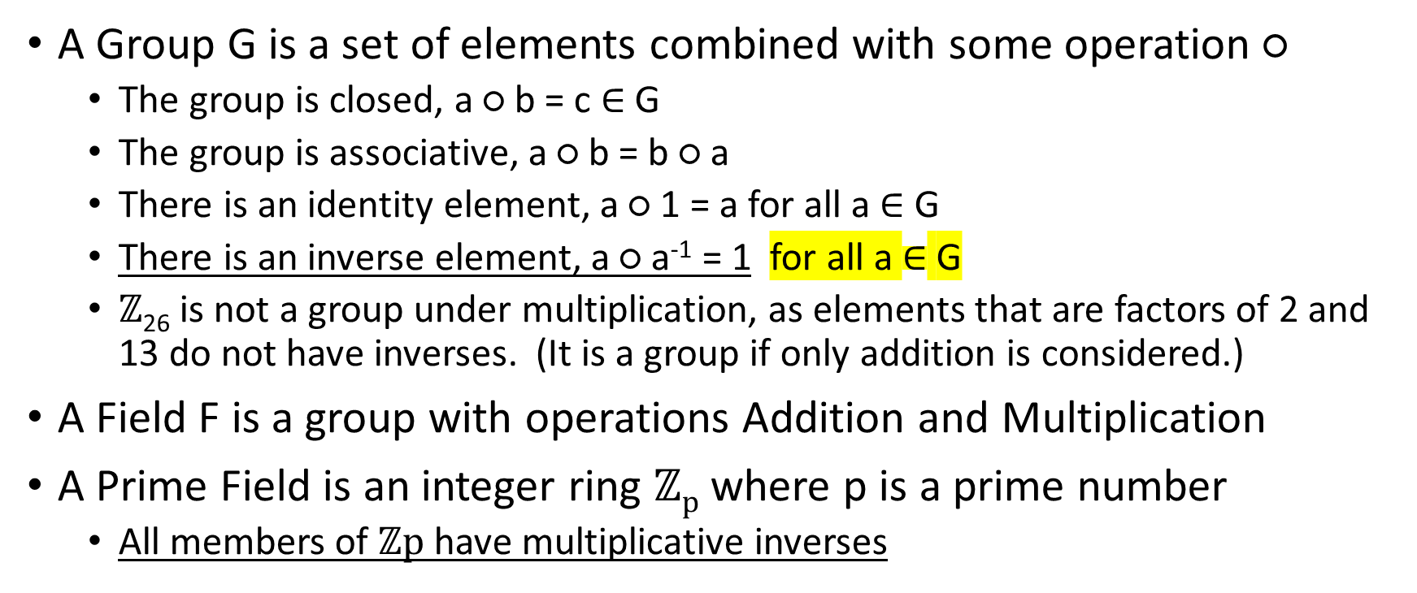
Groups, Fields, and Prime Fields
A Group G is a set of elements combined with some operation ○
The group is closed, a ○ b = c $∈$ G
The group is associative, a ○ b = b ○ a
There is an identity element, a ○ 1 = a for all a $∈$ G
There is an inverse element, a ○ a⁻¹ = 1 for all a $∈$ G
$ℤ$₂₆ is not a group under multiplication, as elements that are factors of 2 and 13 do not have inverses. (It is a group if only addition is considered.)
A Field F is a group with operations Addition and Multiplication
A Prime Field is an integer ring $ℤp$ where p is a prime number
All members of $ℤp$ have multiplicative inverses
Notes:
A group is more abstract than a ring, as it may be any set of elements, and any operation we can invent that satisfies the rules (closed, associative, identity, and inverse.) It requires all elements to have an inverse element. Therefore, $ℤ$₂₆ is not a group under multiplication. It is a group if the only operation is addition.
A field is more specific than a group, as the operators are addition and multiplication. A field is a type of group.
A prime field is an integer ring $ℤp$ where the number of elements is a prime number. Since the only factors of a prime number are 1 and the number itself, all members of $ℤp$ have multiplicative inverses.
If our SYMBOLS group from the Affine cipher had a prime number of members, say 29 instead of 26, we could use any element for A and for B in our encryption, cipherIndex = A * index + B. Then our keyspace would be 29 *29. That’s not great, but it is better than 12 * 26.

